Slide 1
Real Time Driver Drowsiness Detection System
Jay Prakash Kushwaha – 20U02075
Aditya Narayan Jaiswal – 20U02065

Slide 2
Introduction
A real-time driver drowsiness detection system is a technology that uses sensors and algorithms to monitor a driver's level of alertness and detect signs of drowsiness or fatigue. The system aims to prevent accidents caused by driver fatigue, which can lead to loss of control of the vehicle, decreased reaction time, and impaired decision-making abilities.
The system typically uses sensors to track the driver's eye movements, facial expressions, and head position. Algorithms to detect signs of drowsiness, such as drooping eyelids, slow eye movements, and yawning.
If the system detects signs of drowsiness, it can alert the driver through an alarm or vibration. This technology has the potential to significantly reduce the number of accidents caused by driver fatigue, making the roads safer for everyone.

Slide 3
Overview
The system is based on the analysis of the driver's eye and mouth movements, which are captured using a camera mounted on the dashboard or steering wheel of the vehicle. The system analyzes the images captured by the camera to determine the eye aspect ratio (EAR) and mouth aspect ratio (MAR) of the driver.
The EAR is calculated by analyzing the ratio of the distance between the top and bottom eyelids to the distance between the left and right corners of the eye. A lower EAR value indicates that the eyes are closed or partially closed, which could be a sign of driver drowsiness. Similarly, the MAR is calculated by analyzing the ratio of the distance between the upper and lower lips to the distance between the left and right corners of the mouth. A higher MAR value indicates that the mouth is open, which could be a sign of yawning or fatigue.

Slide 4

Overview
The system uses machine learning algorithms to analyze the EAR and MAR values and identify patterns that indicate driver drowsiness. The system is trained on a dataset of drivers exhibiting different levels of drowsiness, allowing it to accurately detect drowsiness and minimize false positives.
When the system detects signs of drowsiness, it triggers an alarm to alert the driver to take a break or rest. The alarm can be a sound, a vibration, or a visual cue, such as a warning light on the dashboard. This alert system can help prevent accidents caused by driver fatigue and improve road safety.

Slide 5
Algorithms and Methods
Machine Learning Algorithms: These algorithms are used to analyze the EAR and MAR values and identify patterns that indicate driver drowsiness. Facial landmark marking involves identifying and tracking specific points on the face, such as the eyes, nose, and mouth, to detect and analyze the driver's facial movements. These points are usually identified using feature detection techniques such as the Scale-Invariant Feature Transform (SIFT) algorithm or the Speeded Up Robust Features (SURF) algorithm.

Slide 6
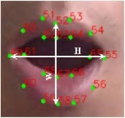
Algorithms and Methods
The algorithms and models used in a real-time driver drowsiness detection system to analyze sensor data and determine driver alertness levels:
Eye Aspect Ratio (EAR) Algorithm: This algorithm calculates the EAR value based on the ratio of the distance between the top and bottom eyelids to the distance between the left and right corners of the eye. A lower EAR value indicates that the eyes are closed or partially closed, which could be a sign of driver drowsiness.
2.Mouth Aspect Ratio (MAR) Algorithm: This algorithm calculates the MAR value based on the ratio of the distance between the upper and lower lips to the distance between the left and right corners of the mouth. A higher MAR value indicates that the mouth is open, which could be a sign of yawning or fatigue.

Slide 7
Block Diagram

Slide 8
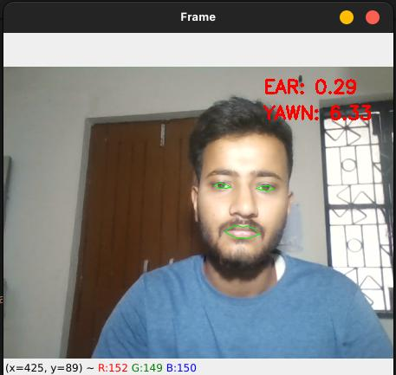
Results

Slide 9
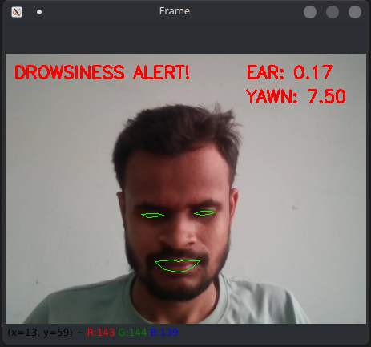
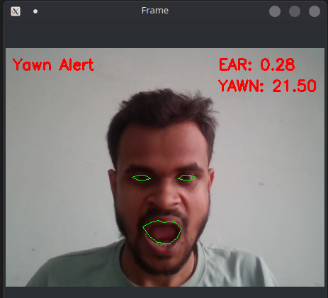
Results

Slide 10
Key Features
Alerts: One of the main features of the system is to alert the driver when signs of drowsiness are detected. This can be done using various types of alerts, such as sound, vibration, or visual cues like a warning light on the dashboard.
Vehicle control: Some advanced systems can be integrated with the vehicle's control systems, allowing the system to take control of the vehicle in case of an emergency. For example, the system can apply the brakes or steer the vehicle to avoid an accident.
Connectivity with other systems: The system can be connected to other safety systems in the vehicle, such as lane departure warning systems or adaptive cruise control, to enhance the overall safety of the vehicle.
Real-time monitoring: The system continuously monitors the driver's alertness levels in real-time, allowing for quick detection and response to signs of drowsiness.
Customizable settings: The system can be customized to suit the driver's preferences, such as adjusting the sensitivity of the system or the type of alerts used.

Slide 11
Benefits of using a Real-Time Driver Drowsiness Detection System
Reduced accidents: Drowsy driving is a significant cause of accidents on the road, and a real-time detection system can help prevent accidents by alerting the driver to take a break or rest before becoming too fatigued to drive safely.
Improved road safety: By detecting signs of driver drowsiness, the system can improve road safety for all road users by preventing accidents caused by drowsy driving.
Lower insurance premiums: Some insurance companies offer discounts or lower premiums for vehicles equipped with safety features like a real-time driver drowsiness detection system. This can save drivers money on their insurance costs.
Increased driver awareness: The system can increase driver awareness of their own driving behavior, including the amount of time spent driving and their alertness levels. This can encourage drivers to take regular breaks and practice safer driving habits.
Improved productivity: For drivers who rely on driving as part of their job, a real-time driver drowsiness detection system can help prevent downtime caused by accidents or injury due to drowsy driving.

Slide 12
Case studies of successful implementations of the system in different industries
Commercial trucking: A major trucking company in the United States implemented a real-time driver drowsiness detection system in its fleet of trucks. The system uses cameras and machine learning algorithms to analyze the driver's face and detect signs of drowsiness
Public transportation: In Singapore, a public transportation company implemented a real-time driver drowsiness detection system in its buses. The system uses a combination of sensors and algorithms to detect signs of driver fatigue, such as erratic steering or slowing down.
Ride-sharing: A ride-sharing company in India implemented a real-time driver drowsiness detection system in its vehicles. The system uses facial recognition technology to detect signs of driver fatigue, such as drooping eyelids or yawning. When signs of fatigue are detected, the system alerts the driver and suggests taking a break or rest. Since implementing the system, the company has seen a significant reduction in accidents caused by drowsy driving and improved safety for passengers.

Slide 13
Future directions and advancements in the field of real-time driver drowsiness detection system
Improved accuracy: One of the main goals for future advancements is to improve the accuracy of real-time driver drowsiness detection systems. This can be achieved by incorporating more advanced machine learning algorithms and incorporating other sensor data, such as heart rate or breathing rate, to provide a more comprehensive picture of the driver's state.
Integration with vehicle control systems: Another area of future advancement is the integration of real-time driver drowsiness detection systems with vehicle control systems. This could allow the system to automatically take control of the vehicle in the event of a drowsy driving incident, potentially preventing accidents.
Artificial intelligence: As the field of artificial intelligence continues to advance, there is potential to incorporate AI-powered assistants that can help keep drivers alert and focused. For example, these assistants could provide audio cues or reminders to the driver to take breaks or adjust their driving habits.

Slide 14
Conclusion
In conclusion, real-time driver drowsiness detection systems have the potential to significantly improve road safety by alerting drivers when they are becoming drowsy or fatigued. These systems use computer vision techniques and machine learning algorithms to analyze eye and mouth movements and identify signs of drowsiness.
While the technology has some limitations and challenges, such as false positives and privacy concerns, are rapidly improving the accuracy and reliability of these systems.
Therefore, it is important for the automotive industry, transportation companies, and policy makers to embrace and encourage the adoption of these systems to improve road safety and reduce the number of accidents caused by driver drowsiness.
By increasing the awareness and adoption of real-time driver drowsiness detection systems, we can work towards creating a safer and more secure transportation system for all. Let us take action now to make the roads a safer place for everyone.

Slide 15
Thank You !

